Slide 1





001
FIND ME
COURSE: CS 382 - SEARCH ENGINES AND INFORMATION RETRIEVAL
PROF : CHAMROEUN KHIM
FIND ME | PARAGON INTERNATIONAL UNIVERSITY

Slide 2
002
WELCOME
TO FIND ME!
Introduction
Modeling
Demo
Conclusion
FIND ME | PARAGON INTERNATIONAL UNIVERSITY
Today's Agenda

Slide 3

003
INTRODUCTION
What is Find Me?
FIND ME | PARAGON INTERNATIONAL UNIVERSITY
WE HAVE 3 MEMBERS:
Monespiseth Ly
Bunnarith Heang
Seakmeng Chheang

Slide 4
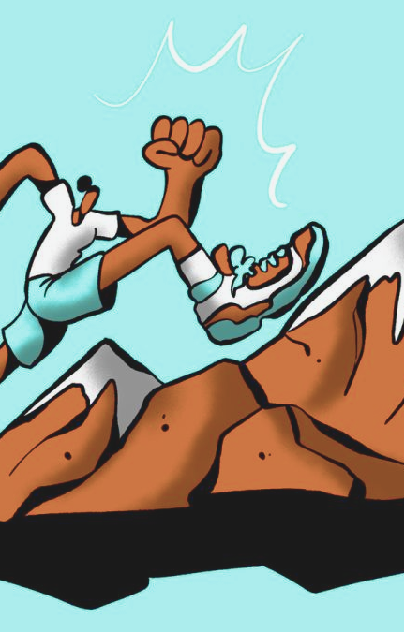
004
INTRODUCTION
Motivation
FIND ME | PARAGON INTERNATIONAL UNIVERSITY

Slide 5

005
INTRODUCTION
Objectives
FIND ME | PARAGON INTERNATIONAL UNIVERSITY

Slide 6
MODELING
FIND ME | PARAGON INTERNATIONAL UNIVERSITY

Slide 7
007
TOOLS
1) Flask
2) Neo4J
3) Flutter
FIND ME | PARAGON INTERNATIONAL UNIVERSITY
For preprocessing and api
For datastore
For User Interface

Slide 8
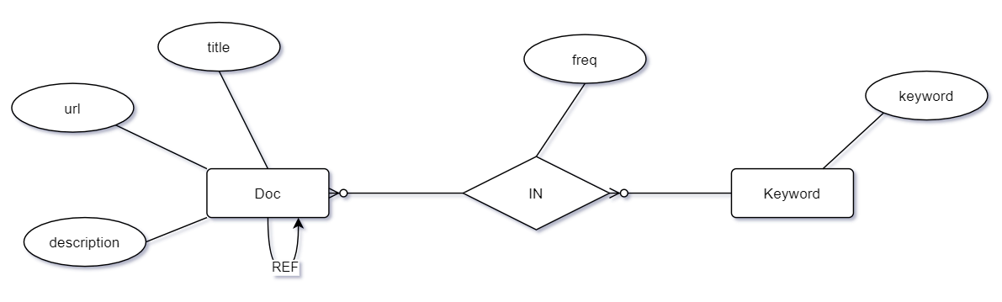
008
DIAGRAM
FIND ME | PARAGON INTERNATIONAL UNIVERSITY

Slide 9
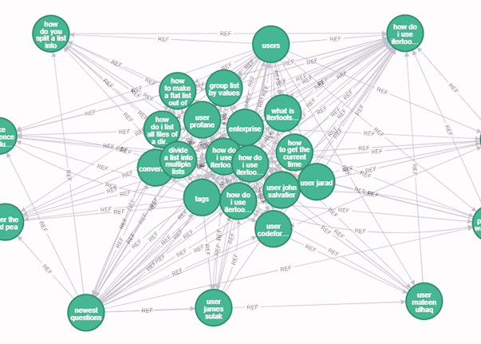
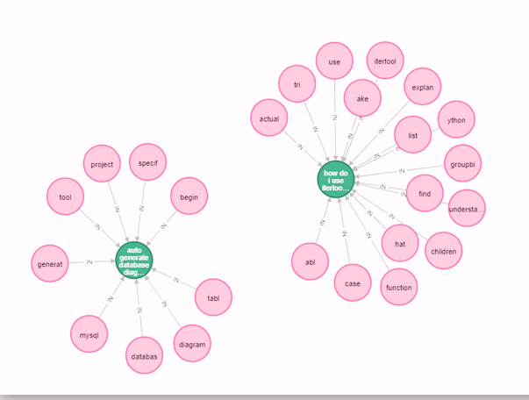
009
Graph representation of
the models
FIND ME | PARAGON INTERNATIONAL UNIVERSITY

Slide 10
010
CRAWLING
Download Information from the webpage
COMPONENTS
INDEXING
Preprocessing to help ranking documents faster
RANKING
FIND ME | PARAGON INTERNATIONAL UNIVERSITY
Real time processing to score and rank document then return to the user

Slide 11
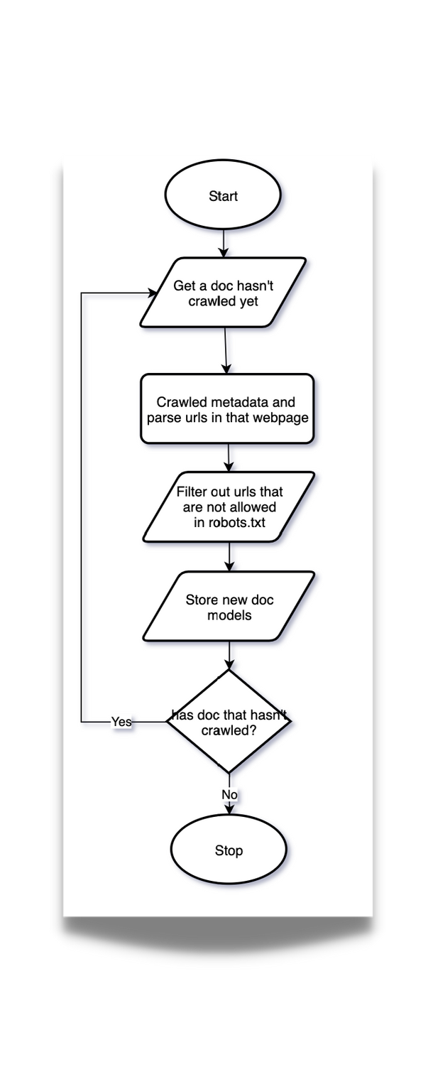
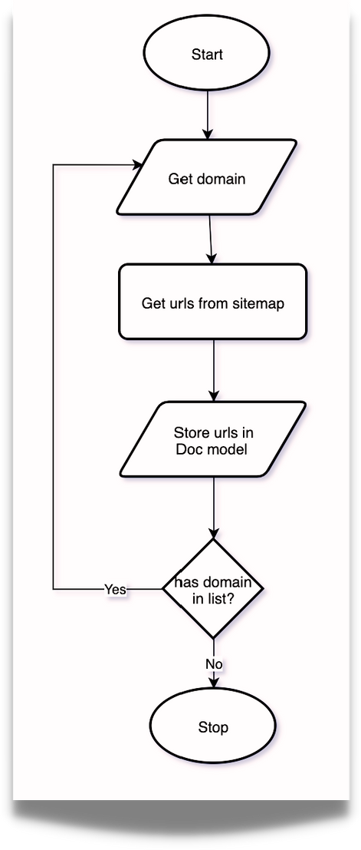
011
CRAWLING
FIND ME | PARAGON INTERNATIONAL UNIVERSITY

Slide 12
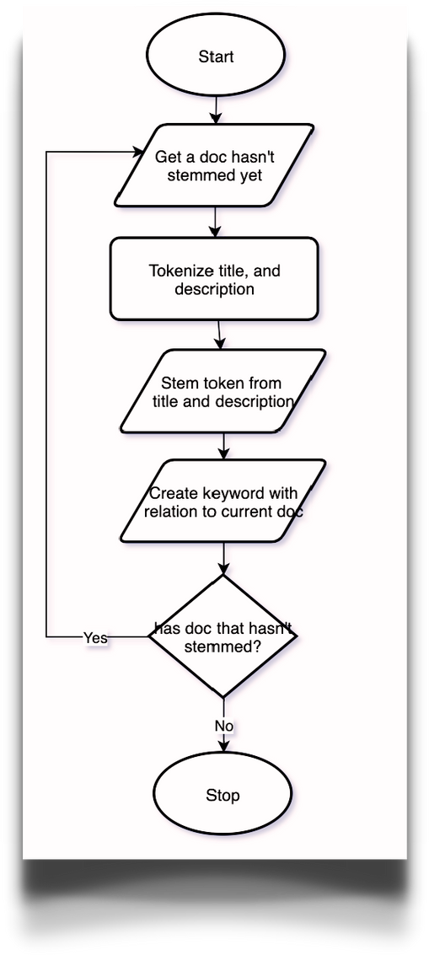
012
INDEXING
FIND ME | PARAGON INTERNATIONAL UNIVERSITY

Slide 13
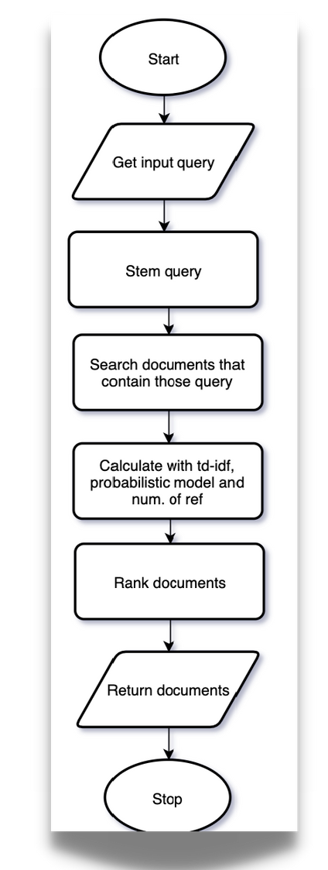
013
RANKING
FIND ME | PARAGON INTERNATIONAL UNIVERSITY

Slide 14

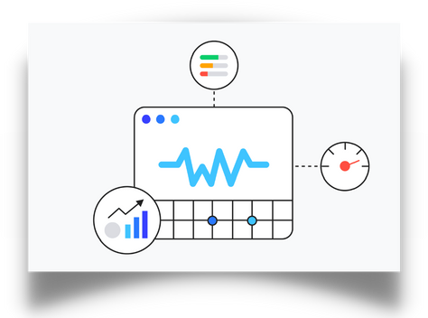
ELIF
CRAWLING & INDEXING
RANKING
FIND ME | PARAGON INTERNATIONAL UNIVERSITY
Fetch web pages
Parse title and description
Breaking into chunk of words (tokenization)
Reduce to base/root form (stemming)
Looking for more links
Tokenization and Stemming user query
Rank documents with bespoke algorithm.

Slide 15
DEMO
FIND ME | PARAGON INTERNATIONAL UNIVERSITY

Slide 16
5K+
7K+
016
Documents
in the datastore
Keywords
in the datastore
STATS
COMPARE TO STACKOVERFLOW
APPROX. 21M+ DOCUMENTS
0.025% completed
FIND ME | PARAGON INTERNATIONAL UNIVERSITY
COMPARE TO INTERNET
APPROX. 4.2B+ DOCUMENTS
0.0001% completed

Slide 17
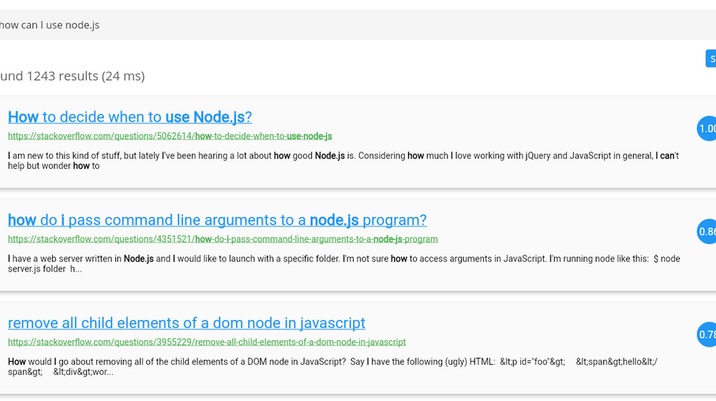
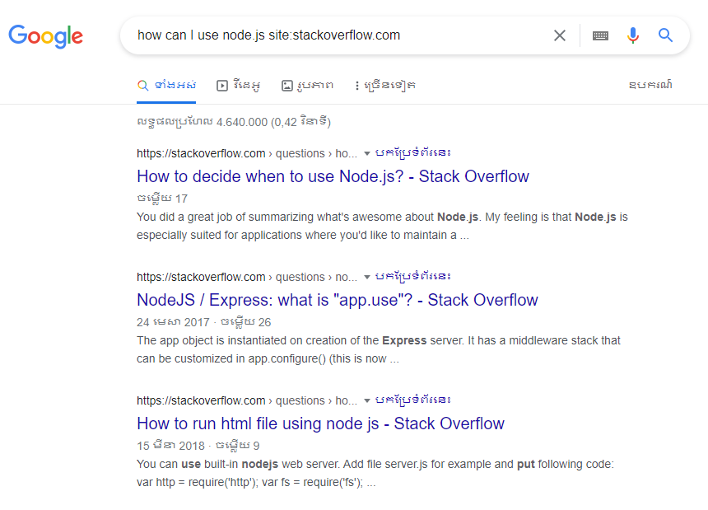
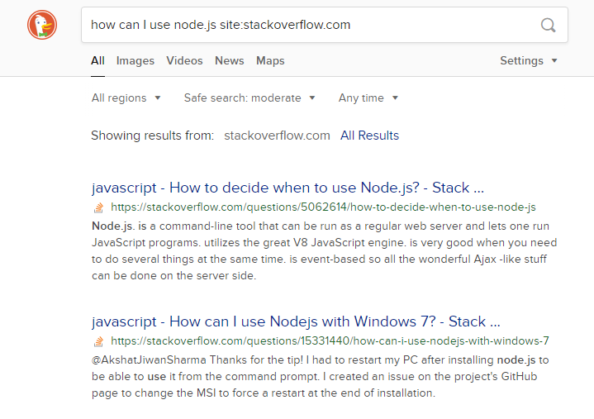
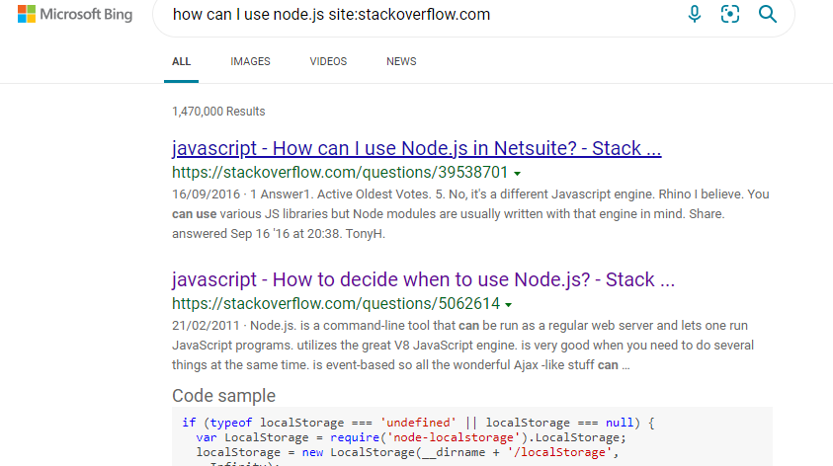

Slide 18
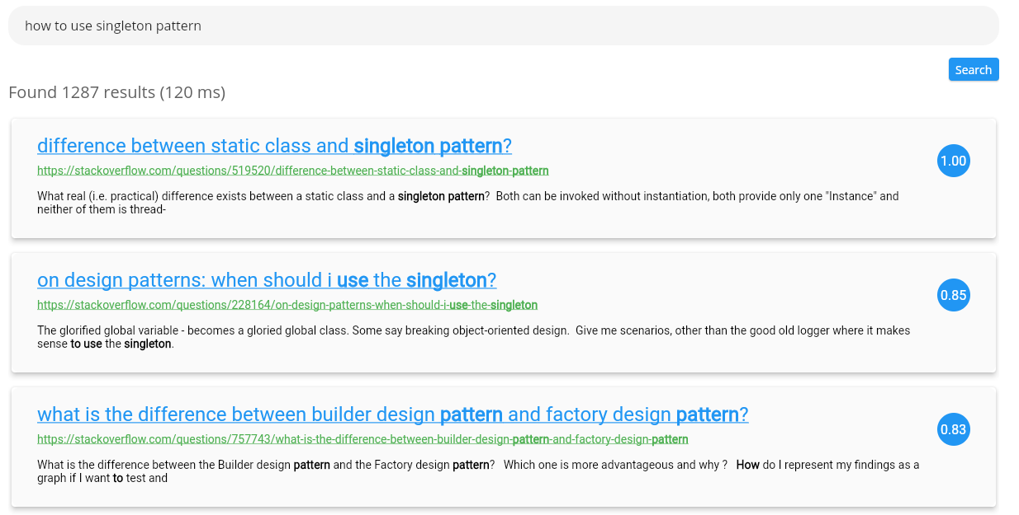

Slide 19
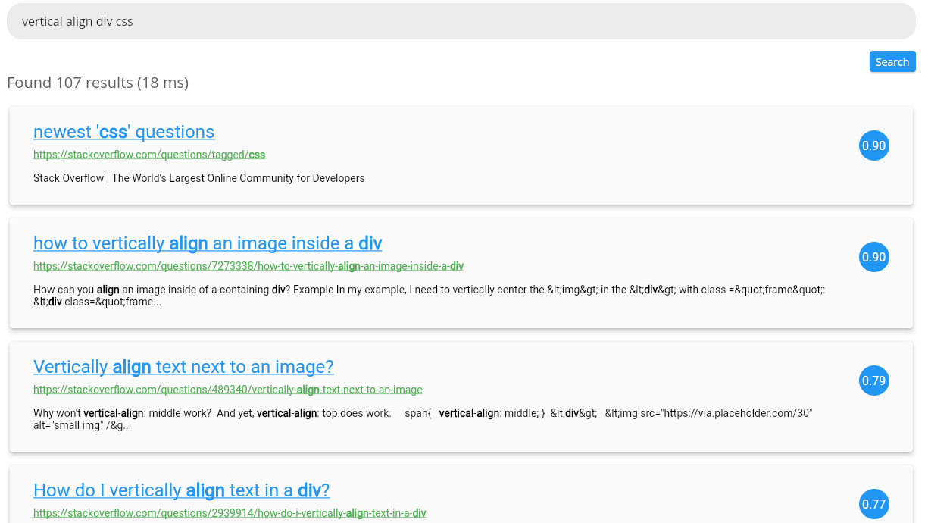

Slide 20
020
Most of the time, users are not reliable source of truth
To make a good search engine, time and resources are needed to produce a good algorithm with computational power to make querying consumes less time.
Search engine algorithms should change after a period of time
CONCLUSION
FIND ME | PARAGON INTERNATIONAL UNIVERSITY

Slide 21
021
THANK YOU FOR JOINING TODAY.
FIND ME | PARAGON INTERNATIONAL UNIVERSITY

